Slide 1
Stock Markets Analysis

Slide 2
Table of contents
01
What is Stock Market
02
Libraries used
03
Exploratory Data Analysis and Risk Management
04
Implementing changes

Slide 3
01
What is stock market?

Slide 4
Stocks are issued by companies in order to raise capitals and are bought by investors in order to acquire a portion of the company.
A Stock market is the place where buying and selling of stocks takes place. Nowadays due to internet and advanced technology buying and selling of stocks takes place anywhere in India and also from foreign country, there is no need to be physical present in exchanges like NSE and BSE. Stock markets are perfect competitive market.

Slide 5
Important terms in stock market
Open – The stock price in the beginning of the day (i.e morning 9:15 A.m)
High – The stock price reached highest level in a day
Low – The stock price reached lowest level in a day
Close - The stock price at which it remains after the end of market timings or the final price of the stock when the market closes for a day.
Volume - Volume is nothing but quantity.
Bid - The Buying price is called as Bid price.
Offer - The selling price is called offer price.

Slide 6
Stock market Conditions
Bull Market – A Bull Market indicates the constant upward movement of the stock market. A particular stock that seems to be increasing in value is described to be bullish.
Bear Market - A bear market indicates the continuous downward movement of the stock market. stock that seems to be decreasing in value is described to be bearish.

Slide 7
02
Libraries Used

Slide 8
Change management approach
Numpy
Pandas
Matplotlib
Seaborn
Datetime
Yfinance
Sklearn
keras

Slide 9
03
Exploratory Data Analysis and Risk Management

Slide 10
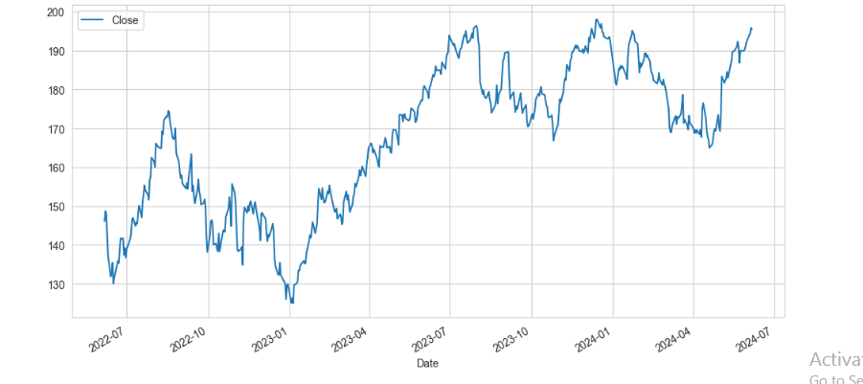
What was the change in price of the stock over time?

Slide 11
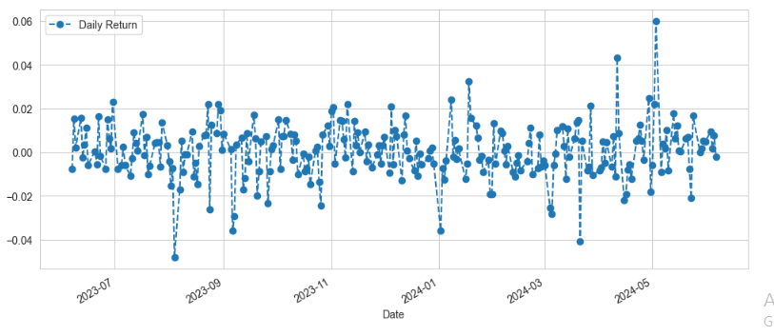
What was the daily return of the stock on average?

Slide 12
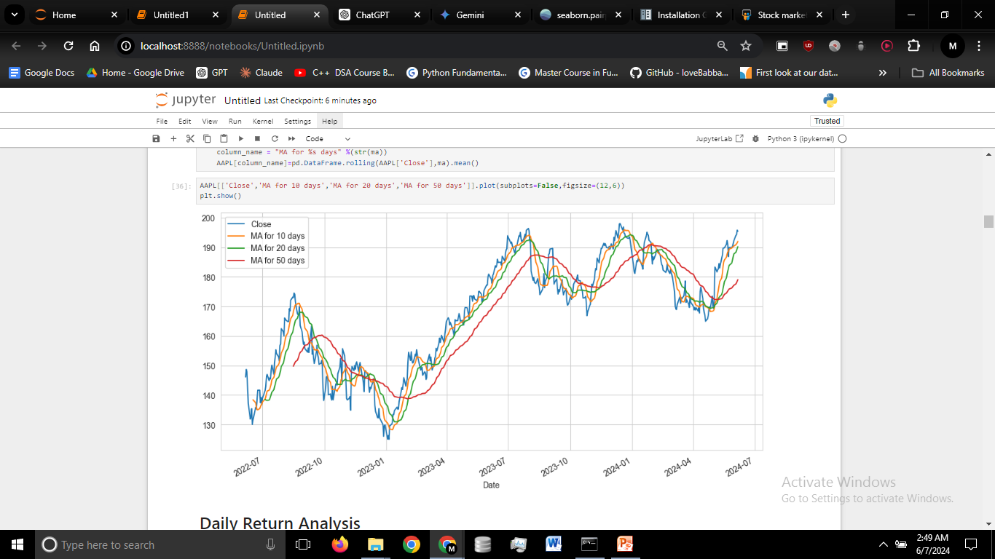
What was the moving average of the various stocks?
A moving average (MA) is a widely used indicator in technical analysis that helps smooth out price action by filtering out the “noise” from random price fluctuations. It is a trend-following, or lagging, indicator because it is based on past prices.

Slide 13
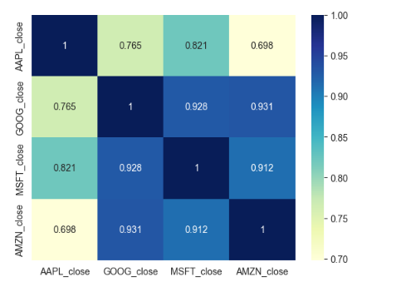
What was the correlation between different stocks' closing prices?
we see here numerically and visually that Amazon and Google had the strongest correlation of daily stock return.
It's also interesting to see that all the technology companies are positively correlated.

Slide 14
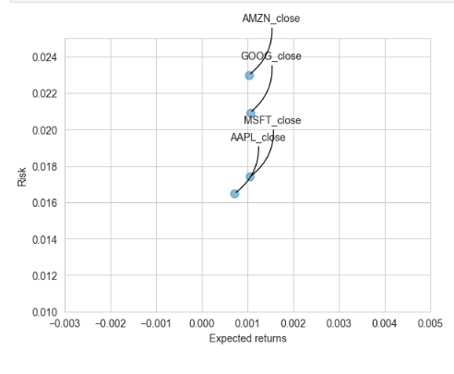
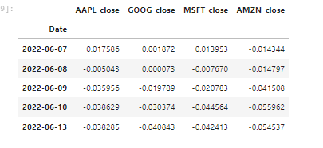
Risk Analysis
By looking at the scatter plot we can say these stocks may have lower risk and a slightly positive expected returns.
There are many ways we can quantify risk, one of the most basic ways using the information we've gathered on daily percentage returns is by comparing the expected return with the standard deviation of the daily returns(Risk).

Slide 15
Value at Risk
Let's go ahead and define a value at risk parameter for our stocks. We can treat value at risk as the amount of money we could expect to lose (aka putting at risk) for a given confidence interval. There's several methods we can use for estimating a value at risk. Let's go ahead and see some of them in action.
40%
60%

Slide 16
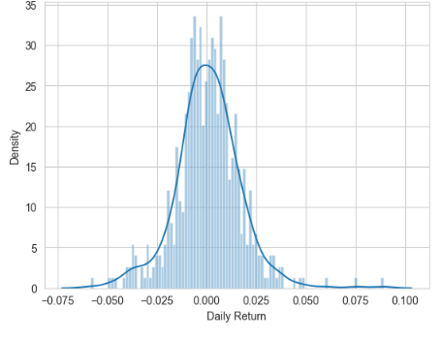
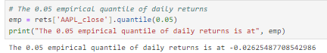
Value at risk using the "bootstrap" method
The 0.05 empirical quantile of daily returns is at -0.024. That means that with 95% confidence, our worst daily loss will not exceed 2.4%. If we have a 1 million dollar investment, our one-day 5% VaR is 0.024 * 1,000,000 = $24,000..
Value at Risk (VaR) is a measure used in finance to estimate the potential loss in value of an investment over a certain period of time, typically within a given confidence level.
For this method we will calculate the empirical quantiles from a histogram of daily returns.

Slide 17
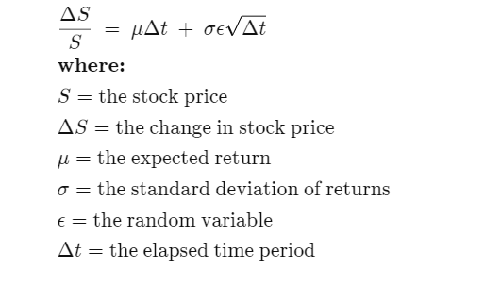
Value at Risk using the Monte Carlo method
Specify a Model (e.g. GBM)
This means the stock price follows a random walk and is consistent with (at the very least) the weak form of the efficient market hypothesis (EMH)—past price information is already incorporated, and the next price movement is "conditionally independent" of past price movements.
A Monte Carlo simulation is an attempt to predict the future many times over. At the end of the simulation, thousands or millions of "random trials" produce a distribution of outcomes that can be analyzed. The basics steps are as follows:

Slide 18
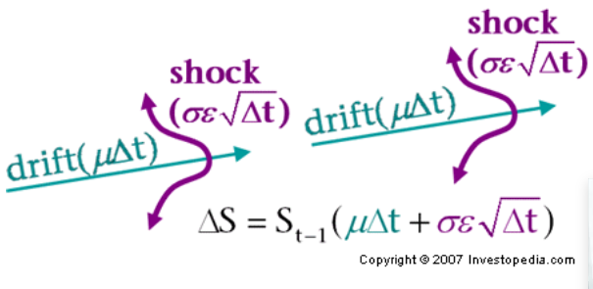
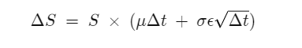
Value at Risk using the Monte Carlo method
​If we rearrange the formula to solve just for the change in stock price, we see that GBM says the change in stock price is the stock price "S" multiplied by the two terms found inside the parenthesis below:
The first term is a "drift" and the second term is a "shock." For each time period, our model assumes the price will "drift" up by the expected return. But the drift will be shocked (added or subtracted) by a random shock. The random shock will be the standard deviation "s" multiplied by a random number "e." This is simply a way of scaling the standard deviation.

Slide 19
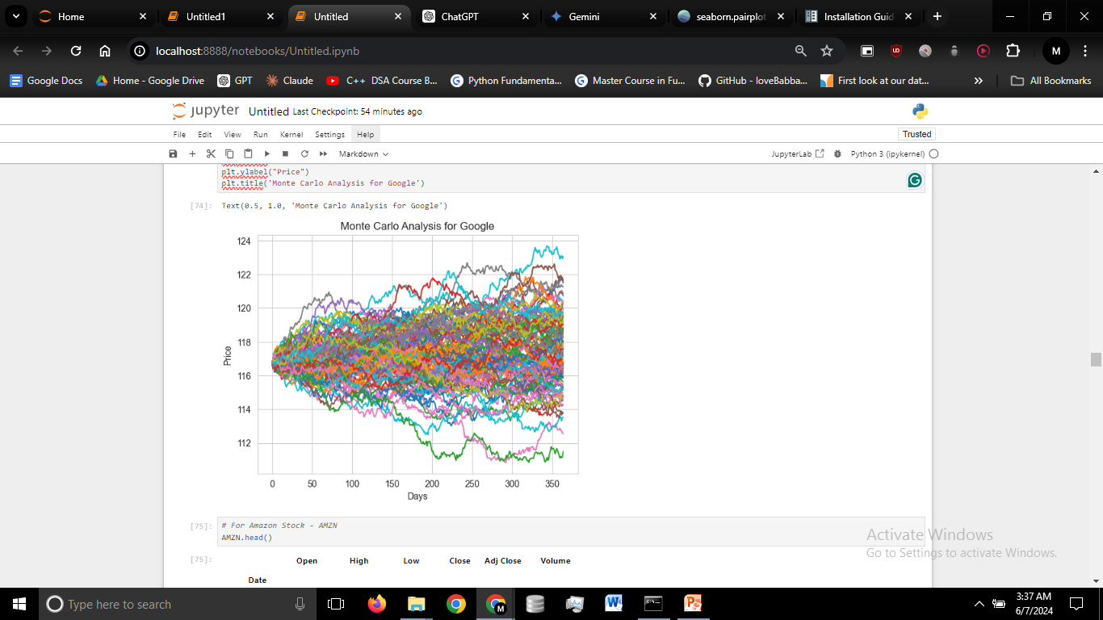
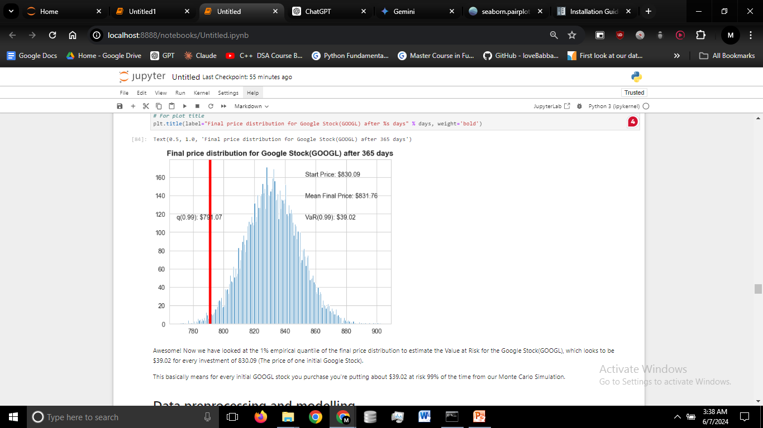
Awesome! Now we have looked at the 1% empirical quantile of the final price distribution to estimate the Value at Risk for the Google Stock(GOOGL), which looks to be $39.02 for every investment of 830.09 (The price of one initial Google Stock).
This basically means for every initial GOOGL stock you purchase you're putting about $39.02 at risk 99% of the time from our Monte Carlo Simulation.
Generate Random Trials
With the model in hand, we start running tests by trying out different scenarios randomly.

Slide 20
—Rakesh Jhunjhunwala
Thanks!
“Markets are like Women
-always commanding,
Mysterious, unpredictable
And volatile .”

